Slide 1
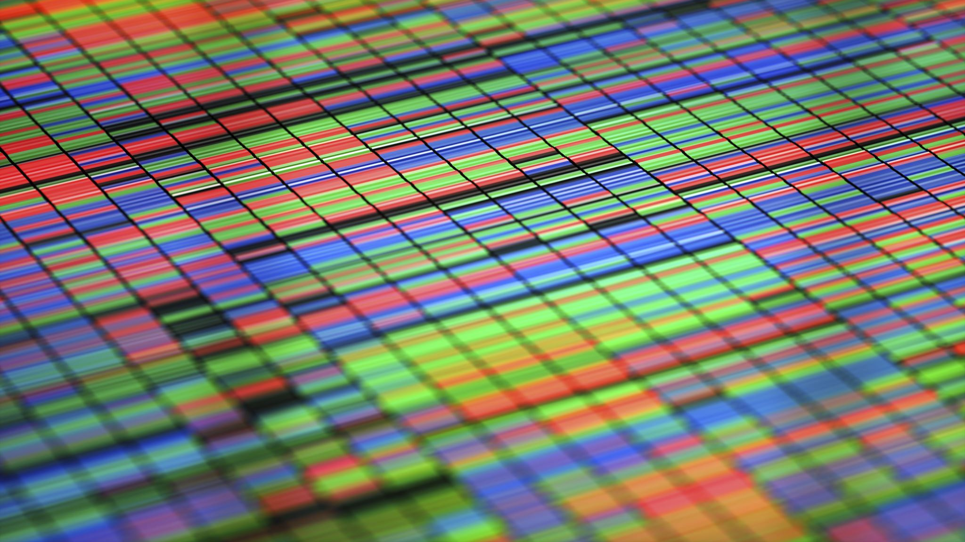
Statistics of Radioactive Decay I
RT4220 – Lecture #5
Kedree Proffitt
WSU
09/02/2025

Slide 2

Terminology
Radioactivity is spontaneous
  Cannot predict PRECISE moment
  Can model statistically
$N_{x}$ – number of remaining radioactive atoms of a given radionuclide $x$
$λ_{x}$ – decay constant for a given radionuclide $x$
  Probability of decay of individual atom during given time period [time^-1]
  $λ=0.01 \left[\frac{1}{s}\right]$ means 1% chance of atom decay per second
$Δ __$ – means change in __
  Thus $ΔN$ is the change in the number of remaining…
  $Δt$ is change in time
$N(t)$ – means the number of remaining… at a given time $t$, $t$ can be any number, positive, zero, negative, and is relative

Slide 3
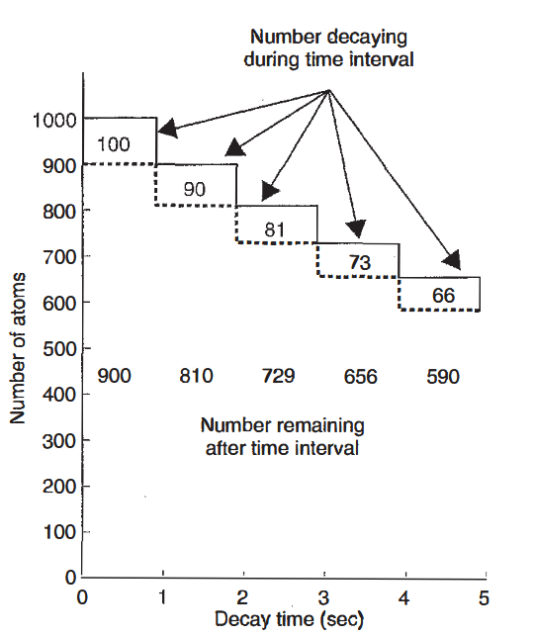

Catching the Vibe
If for every second 10% decays, the number decaying per second will decrease
  100 -> 90 → 81
  Thus, $\frac{ΔN}{Δt}$ is negative
$\frac{ΔN}{Δt}=−λN$ is how we represent the above and right
  $\left|\frac{ΔN}{Δt}\right|=λN=A$ which is the “activity”
  $λ$ is the decay constant
Through calculus we determined that $N(t)=N(0)e^{−λt}$

Slide 4
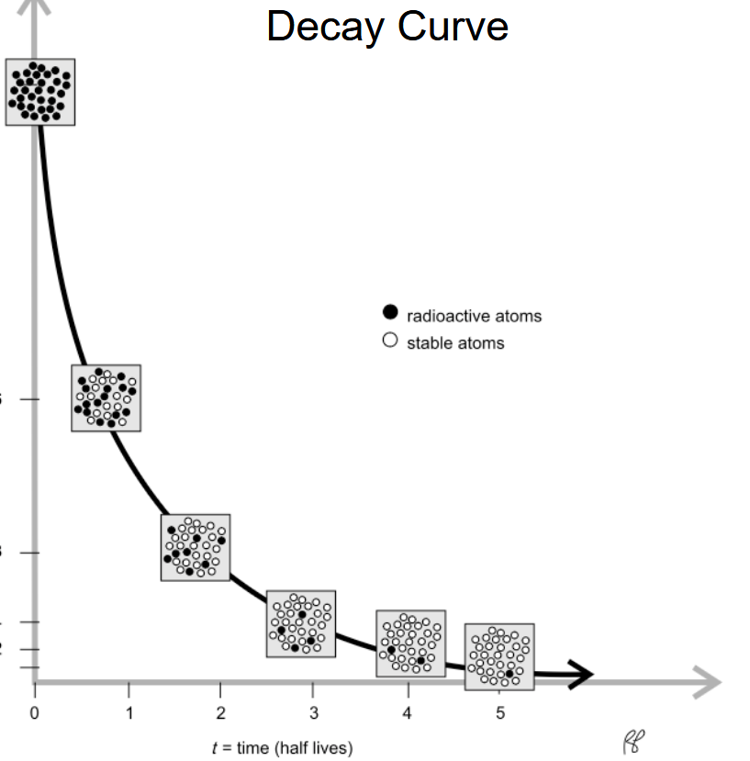

Vibe Part 2
As the sample decays there is an exponential pattern
$e^{−λt}$ is our exponential function
Eventually, the whole sample decays to the daughter

Slide 5

Decay Constant
Defined as the proportion of a sample that will decay during a given time period
Characteristic of radionuclides (does NOT change for any GIVEN radionuclide)
Also: the probability that any given atom will decay during that time period
If there are multiple modes of decay the total decay constant is the sum of the individual constants for each mode
  $λ=λ_{1}+λ_{2}+λ_{3}...$
This yields the DECAY EQUATION:
$$N(t)=N(0)e^{−λt}$$

Slide 6

Activity
Activity is defined as the average decay rate
Mathematically defined as $\left|\frac{ΔN}{Δt}\right|=\left|−λN\right|=A$
  Activity at a given time $t$ is represented as $A(t)$
Units: decays per second [dps]/decays per minute [dpm] OR Curie [Ci] which is $3.7×{10}^{10}$ dps
  dps is the definition of the Becquerel [Bq]
  Ci originally defined as the activity of 1 g of Ra-226, was later changed very slightly
Actual decay rate fluctuates

Slide 7

Decay Factor
Decay factor is defined as the fraction of radioactive atoms REMAINING after time $t$
  $\text{DF}=e^{−λt}$
Reminder: $e=2.718...$ This is the base of natural logarithms
Decay factor is exponential function, as time goes on the factor gets exponentially smaller

Slide 8






The Activity Equation
(THE MOST IMPORTANT)
$$A(t) = A(0) e^{−λt}$$
This comes from substitution of previous equations:
$$∵A=λN$$
$$∵N(t)=N(0) e^{−λt}$$
$$λ×N(t)=λ×N(0){ e}^{−λt}→$$
$$A(t) = A(0){ e}^{−λt}$$

Slide 9

Half-Life 3
Defined as the time it takes for the sample to decay to half of its INITIAL activity level
Directly related to the DECAY CONSTANT:
$$T_{1/2}=\frac{\ln{2}}{λ}$$
$$λ=\frac{ln 2}{T_{1/2}}$$
Most of the time, we use half-life instead of decay constant

Slide 10

Average Lifetime
Defined as the average time that a radioactive atom sticks around until it decays
THIS IS THE INVERSE OF DECAY CONSTANT… LITERALLY
  Probability of decay of individual atom… VS. average time that a radioactive atom… until it decays
Inverse mathematically too:
$$τ=\frac{1}{λ}$$
thus
$$τ=\frac{T_{1/2}}{\ln{2}}$$

Slide 11
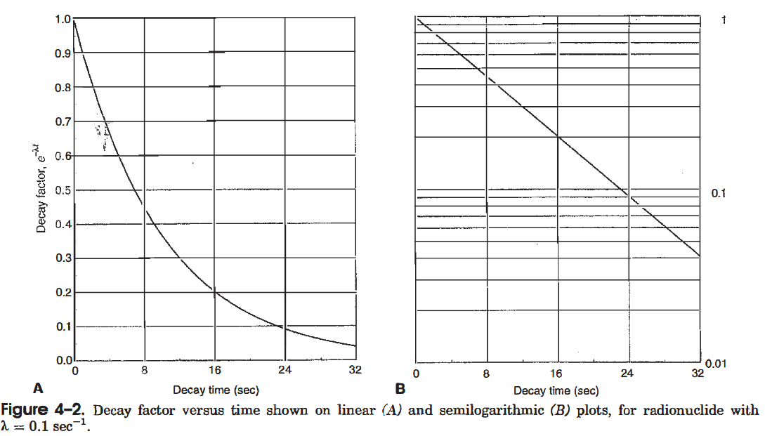
Semi-log Plots

Slide 12
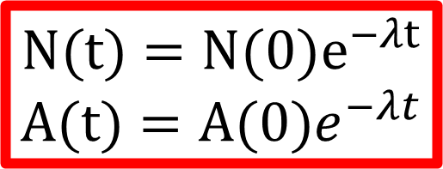
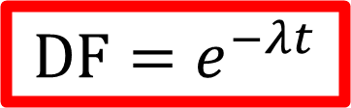
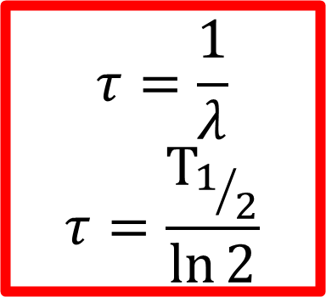
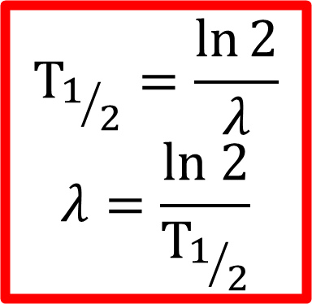
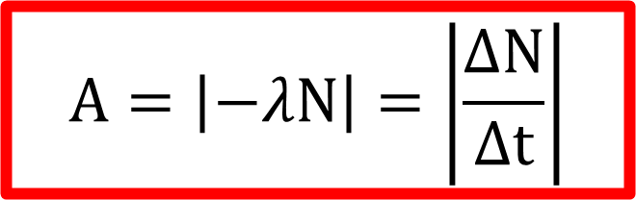
Important Equations
$$\text{DF}=e^{−λt}$$
$$N(t)=N(0)e^{−λt}$$
$$A(t)=A(0)e^{−λt}$$
$$A=\left|−λN\right|=\left|\frac{ΔN}{Δt}\right|$$
$$τ=\frac{1}{λ}$$
$$τ=\frac{T_{1/2}}{\ln{2}}$$
$$T_{1/2}=\frac{\ln{2}}{λ}$$
$$λ=\frac{ln 2}{T_{1/2}}$$

Slide 13

Practice: Finding Half-Life
What is the half-life of an isotope with a decay constant of $2.6×{10}^{−6} {\text{s}}^{−1}$ ?
$$T_{1/2}=\frac{\ln{2}}{λ}$$
$$T_{1/2}=\frac{0.693}{2.6×{10}^{−6}}≅266,538 \text{s}≅3 \text{days}$$

Slide 14

Practice: Finding Mean-Life
What is the mean-life of an isotope with a half-life of 4 days?
$$τ=\frac{T_{1/2}}{\ln{2}}$$
$$τ=\frac{4}{\ln{2}}=4×1.44≅5.8 \text{days}$$

Slide 15

Practice: Manipulating Decay Equation
75% of a given radioisotope sample has decayed over the course of an hour. What is the decay factor? Also, what is the half-life in minutes?
$$DF=\frac{N\left(60\right)}{N\left(0\right)}=\frac{25\%}{100\%} =0.25⟶$$
$$DF=e^{−λt}⟶0.25=e^{−λ×60}→\ln{0.25}=−60λ→λ=−\frac{\ln{0.25}}{60}→$$
$$λ=\frac{\ln{2}}{T_{1/2}}→\frac{\ln{2}}{T_{1/2}}=−\frac{\ln{0.25}}{60}→T_{1/2}=−\frac{60×\ln{2}}{\ln{0.25}}=30 \text{minutes}$$

Slide 16

Practice: Manipulating Activity Equation
The activity of a radioisotope sample is measured to be 370 MBq at time $t=1800$ s. What was the initial activity of the sample in mCi if the decay constant for this radioisotope is 0.04 ${\text{hr}}^{−1}$.
$$0.04 \frac{1}{hr}×\frac{1}{3600}\frac{hr}{s}=1.11{×10}^{−5}\frac{1}{s}$$
$$A(1800)=A(0){ e}^{−λ×1800}→A(0) \left[mCi\right]×\frac{10 \left[mCi\right]}{e^{−(1.11×{10}^{−5})×1800}}≅10.2 mCi$$

